Slide 1

GOVERNMENT COLLEGE OF ENGINEERING CHANDRAPUR
ELECTRONICS AND TELECOMMUNICATION ENGINEERING DEPARTMENT
PROJECT GUIDE – Prof. h.m. raza
- PRESENTATION -
“Mine bot explorer”

Slide 2
PRESENTATION FLOW
INTRODUCTION
OBJECTIVE
DEVELOPMENT MODULES
SENSORS MODULES
HARDWARE COMPONENTS
SOFTWARE USED
PROJECT APPLICATION
LIMITATIONS
CONCLUSION
FUTURE ENHANCEMENT

Slide 3
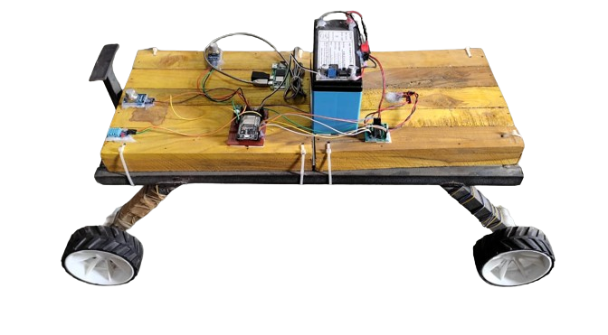
INTRODUCTION
MINE BOT refers to the :
Full automation or remote control mining equipment,
Includes both fixed and mobile machines,
Improves the feasibility, safety, productivity, and efficiency of the modern operations.

Slide 4
OBJECTIVES
LIVE VIDEO STREAMING
Live streaming for video of real-time happenings to mobile viewers over the internet.
ENVIRONMENTAL PARAMETER TRACKING
Parameter like Smoke , Temperature, Humidity and Methane.

Slide 5
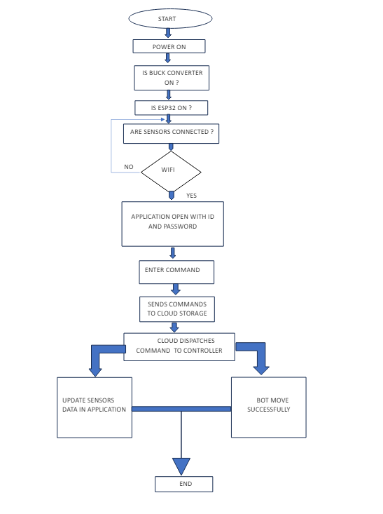
BLOCK DIAGRAM

Slide 6
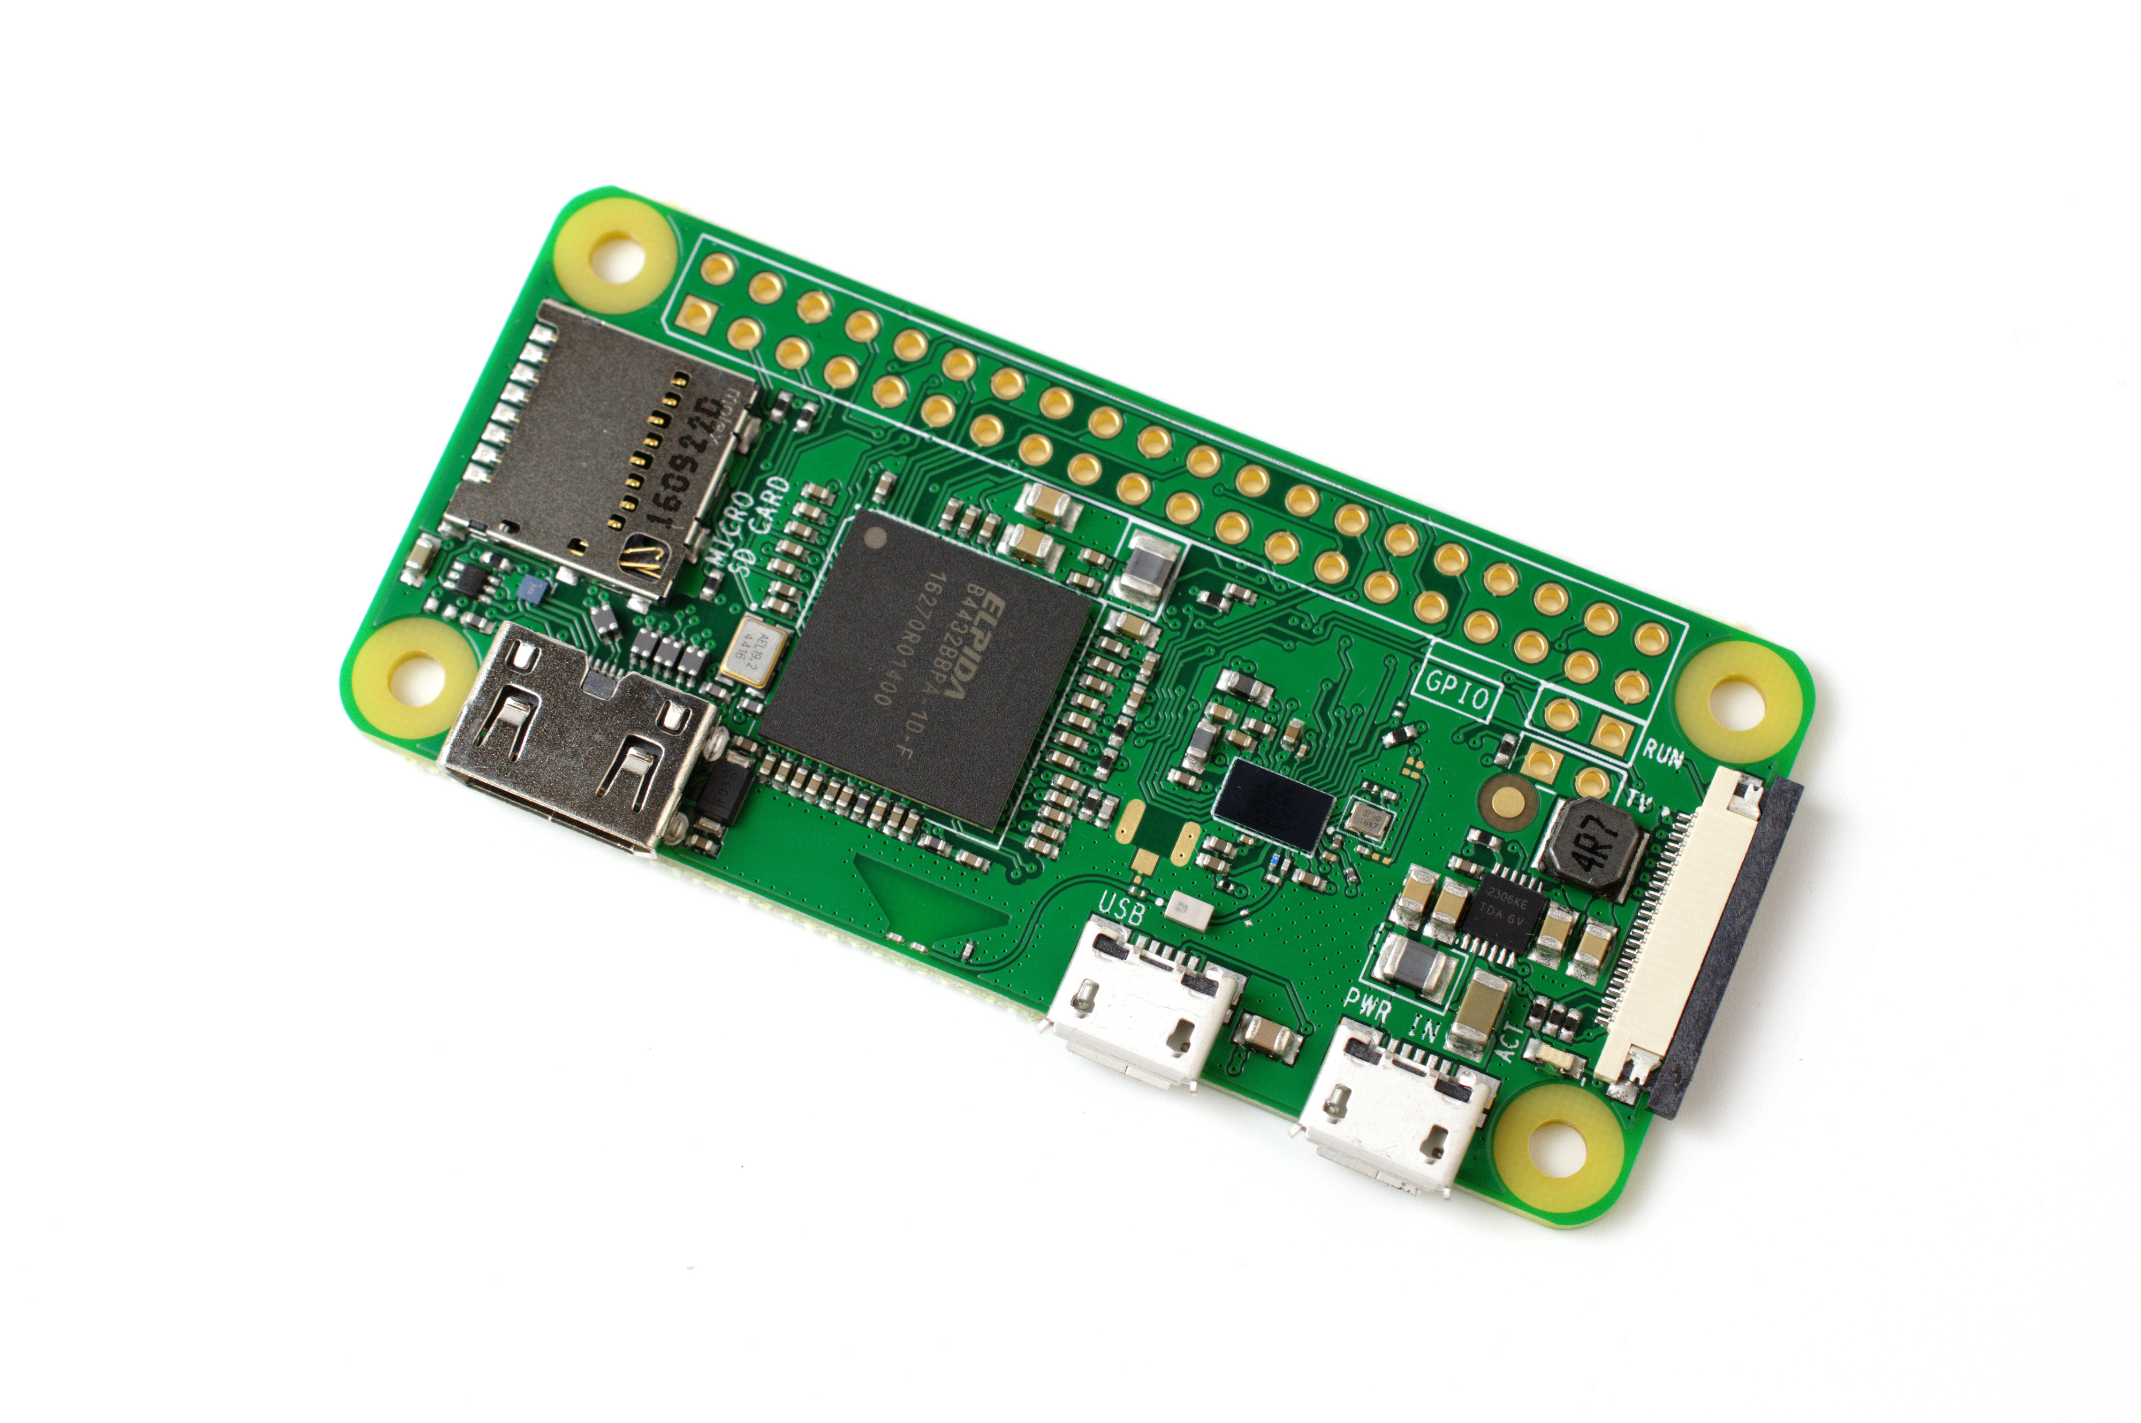
DEVELOPMENT MODULE :
SPECIFICATION OF RASPBERRY PI ZERO
1GHz single-core CPU
512MB RAM
Micro USB OTG port
Micro USB power
Composite video and reset headers
CSI camera connector (v1.3 only)

Slide 7
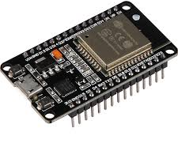
SPECIFICATION OF ESP32
Model. NodeMCU ESP32.
Clock Frequency: 240 MHz
802.11n (2.4 GHz), up to 150 Mbps
448 KB ROM • 520 KB SRAM

Slide 8
Sensor Modules
Sensor is a device that -
Measure physical properties and characteristics from the environment
Convert it to electrical signals .
Data can be interpreted, displayed, or used for control purposes.
TYPES OF SENSORS -
Temperature and Humidity (DHT-11) Sensor
Methane Sensor ( MQ-4 )
Gas Sensor ( MQ-135 )

Slide 9
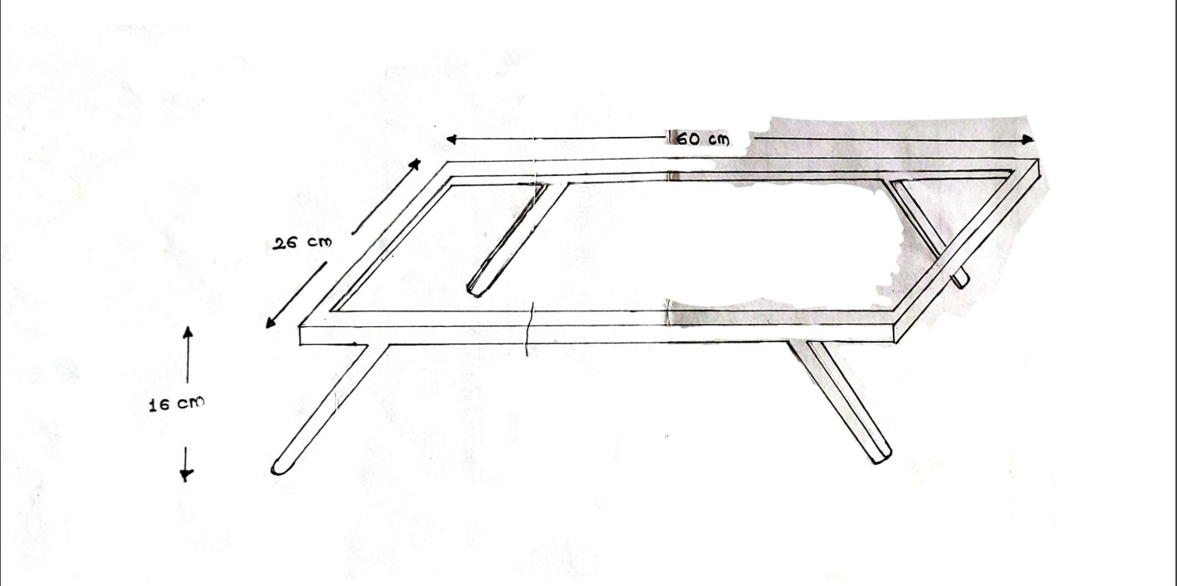
HARDWARE PARTS
CHASSIS
The term generally represents the structural framework or base on which the other components of the robot are mounted.
Provides support for various sensors, actuators, control systems, and power sources.
The choice of material depends on factors such as weight, strength, and cost.

Slide 10
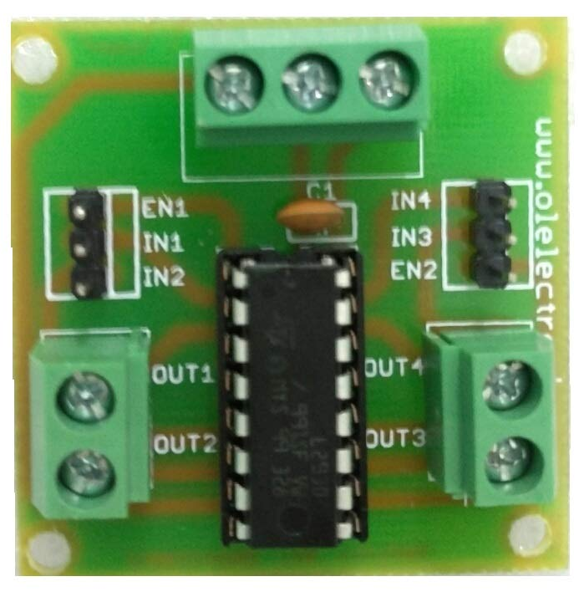
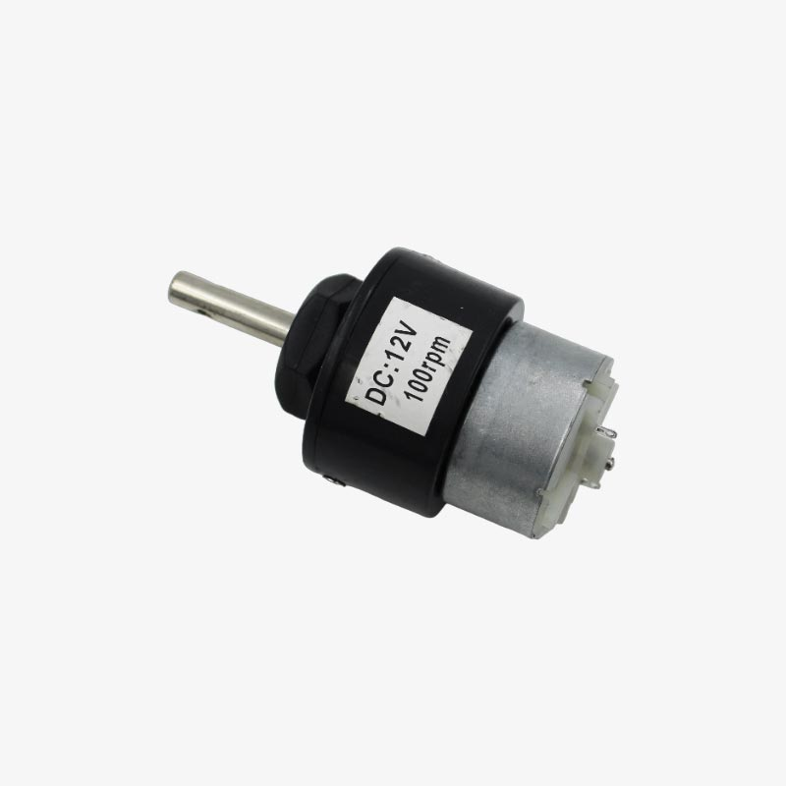
MOTORS & MOTOR DRIVERS
DC 12 Volt 100 RPM MOTOR
Light Weight
Low Speed
High torque
MOTOR DRIVER
Voltage compatibility(handle 12volt Dc motors
Current protection(as a safeguard)
Reliable operation

Slide 11
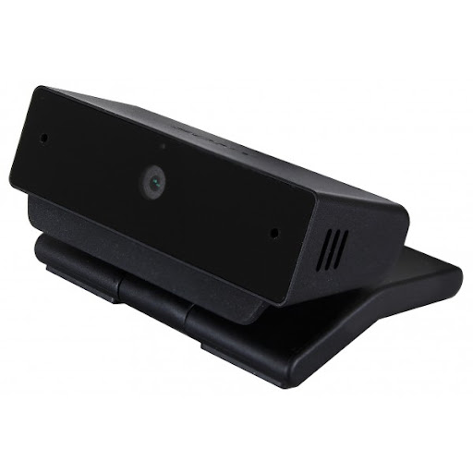
CAMERA MODULE
SONY CMU BR-300
Designed for broadcast
Live event coverage
Offer HD resolution
Various connectivity options
Tilt and zoom capabilities

Slide 12

SOFTWARE
FOR SYSTEM DEVLOPMENT :
We have used VLC.VLC is known for its versatility and wide range of supported multimedia formats, codecs, and streaming protocols.
FOR APPLICATION DEVLOPMENT :
Blynk IOT(Cloud server)
Blynk provides a library of pre-built widgets such as buttons, sliders, graphs, and displays that can be easily integrated into IoT projects.
Blynk offers cloud-based connectivity, allowing users to remotely monitor and control their IoT devices from anywhere with an internet connection.

Slide 13
PROJECT APPLICATION & SCOPE
MINING PURPOSE
Remote Operation and Monitoring
Underground Exploration and Mapping
Data Collection and Analysis
MILLITARY PURPOSE
Surveillance and Reconnaissance
Search and Rescue

Slide 14
LIMITATIONS
Communication Range:
Limited communication range may hinder remote operation and data transmission, especially in deep or underground mining environments.
Environmental Impact:
While mini bots aim to reduce environmental impact, their operations could still disturb ecosystems and habitats, especially in sensitive environments.
Limited Payload Capacity:
Mini mining bots may have limited payload capacity, restricting the amount of material they can extract or transport at once.

Slide 15
CONCLUSION
The Mine Bot can effectively solve the problem statement via featuring
- Live Video Streaming ,
- Environmental Parameter Tracking
The insights gained from this endeavor will not only benefit to mining areas but also pave the way for future developments in Mining Areas/Industries/Military Applications

Slide 16
FUTURE ENHANCEMENT
Energy Scavenging
Energy scavenging refers to the process of collecting small amounts of energy from the surrounding environment and converting it into electrical power for electronic devices.
Energy scavenging is often used in low-power electronic devices and sensors where replacing or recharging batteries is inconvenient or not feasible.
Increases the lifespan and reduces the environmental impact of electronic devices.
Various technologies are employed for energy scavenging, including piezoelectric materials, thermoelectric generators, and solar cells.

Slide 17
IMAGE PROCESSING
The image processing technique is used to check if the detected object is a mine or not.
When an object is detected, the microcontroller sends a message to stop the manipulator and the camera takes a snapshot of the proposed target and sends it also to the computer.
The algorithm analyzes the captured image and compares it with what is inside the saved databases using the MATLAB toolbox of image processing.

Slide 18
THANK YOU

